Slide 1
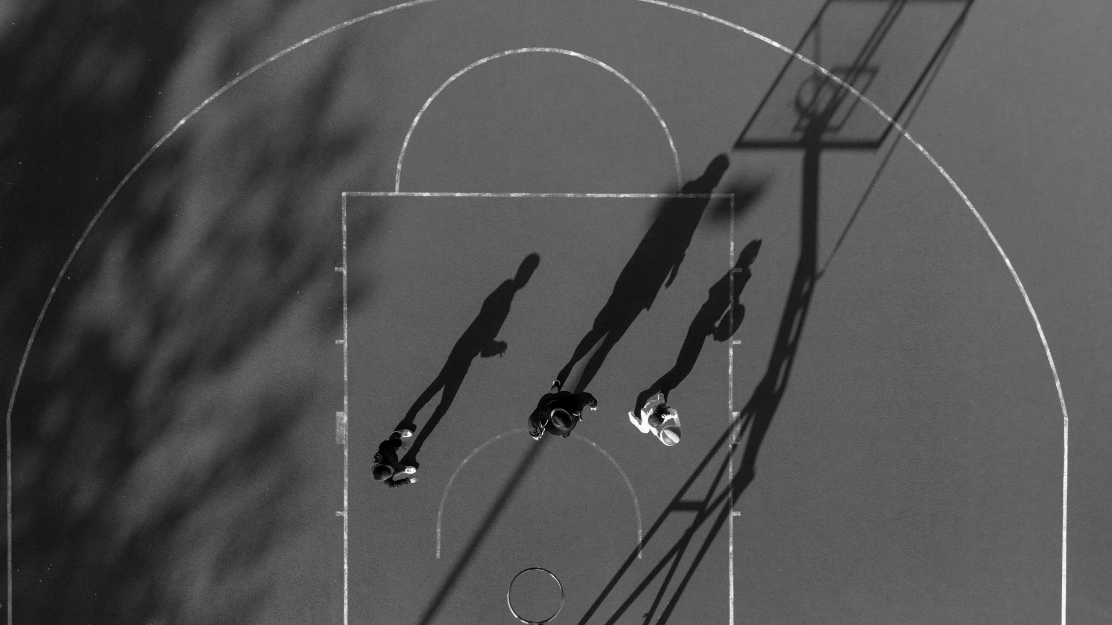
Thyroid Cancer Detection Using Machine Learning
March 2k25

Slide 2
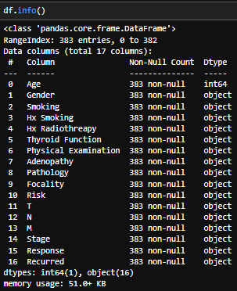
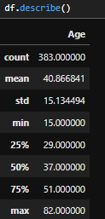
Dataset
Basic Dataset Information
Descriptive Statistics

Slide 3
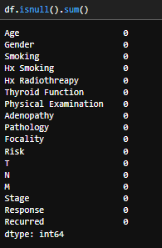
Data Preprocessing
Null Value Count
If there is any missing value we will take Action:
Dropped rows with critical missing values.
Used mean imputation for minor numerical features.

Slide 4
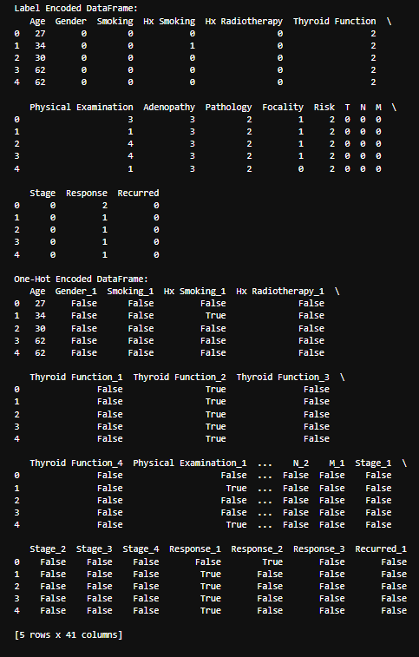
Data Preprocessing
Converted categorical features into numeric format using Label Encoding, One-Hot Encoded dataframes.
Handled missing values and cleaned the dataset.

Slide 5
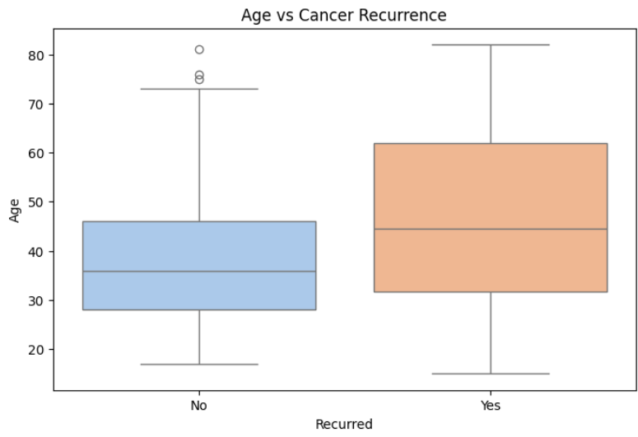
Target Variables
– "Recurred"
(Cancerous vs Non-Cancerous).

Slide 6
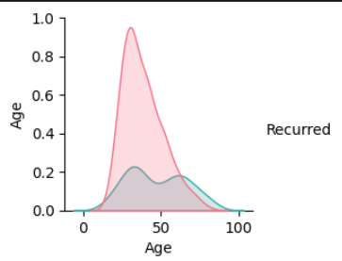
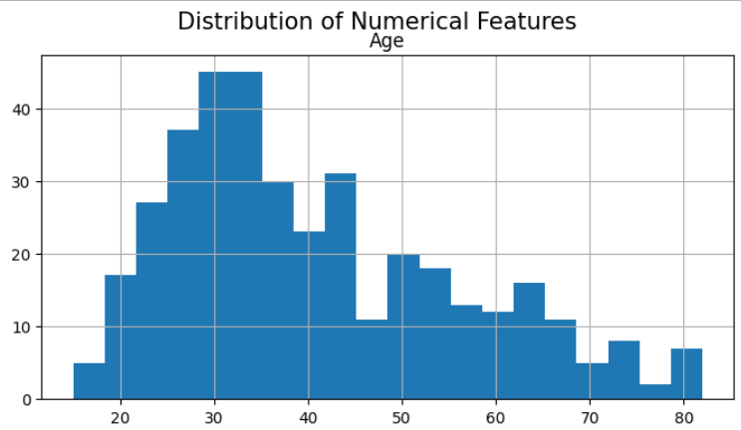
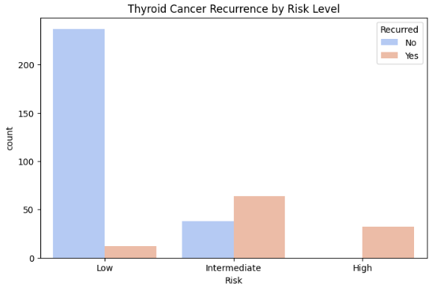
Exploratory Data Analysis(EDA)
Pairplot
Histograms
Class distibutions
Displays relationships between features, with target variable (cancerous vs non-cancerous) as hue.
Shows the distribution of numerical features (e.g., age, hormone levels).
Bar plot showing the distribution of the target variable (cancerous vs non-cancerous).
Business Name
Mobile app development

Slide 7
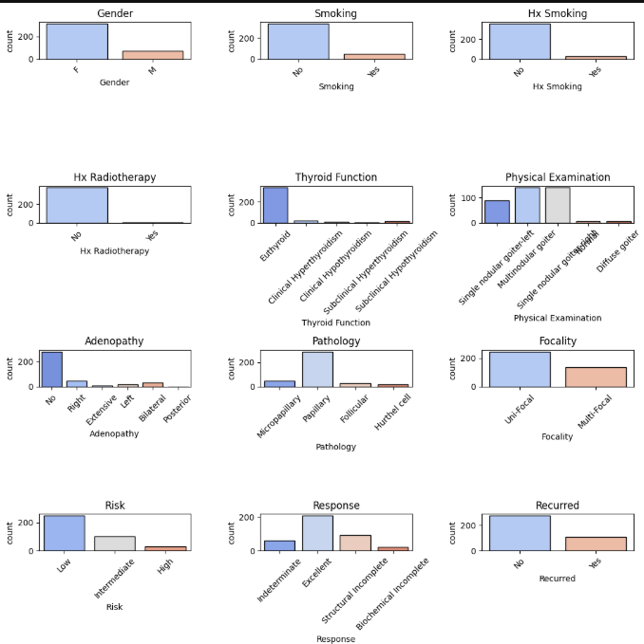
categorical variables

Slide 8
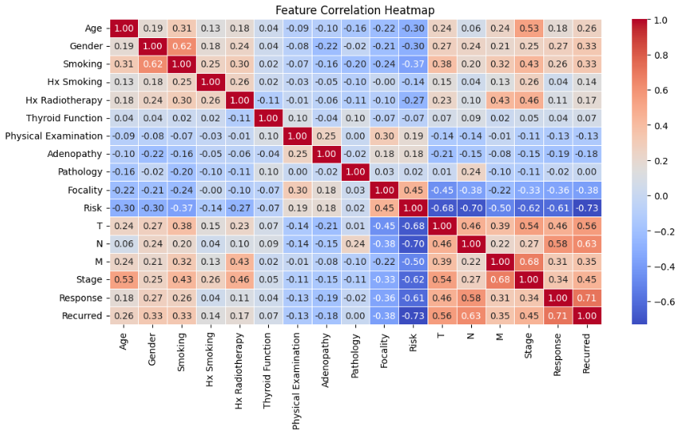
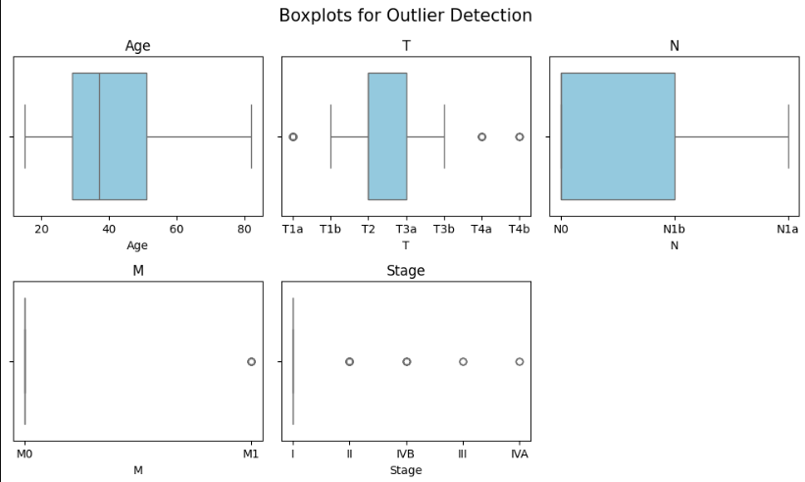
Correlation Heatmap: Highlights the correlation between features to identify key relationships.
Outliers Detection:
Boxplot: Identifies outliers in key features such as age or thyroid levels.
Business Name
Mobile app development

Slide 9
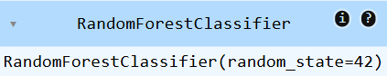
Model Selection
Trained multiple ML models to compare performance:
Random Forest Classifier
Handles both categorical and numerical features well.
Robust to outliers and noise.
Works great for classification tasks with imbalanced datasets.
Automatically handles feature importance.
Business Name
Mobile app development

Slide 10
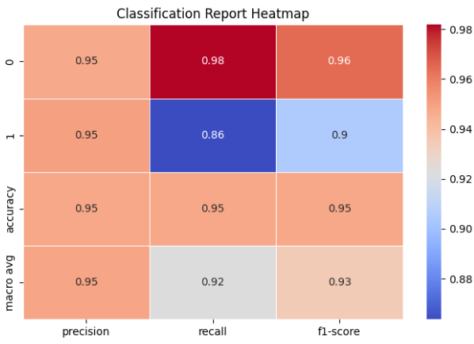
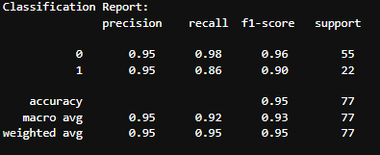
Model Evaluation
Classification Report
Business Name
Mobile app development

Slide 11
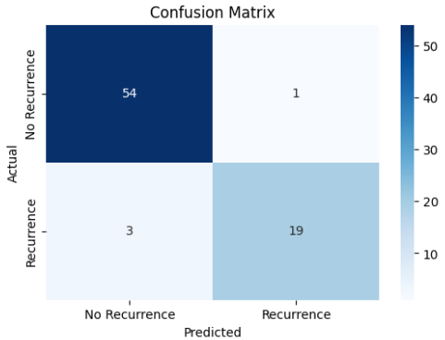
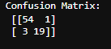
Confusion Martix
Heatmap

Slide 12
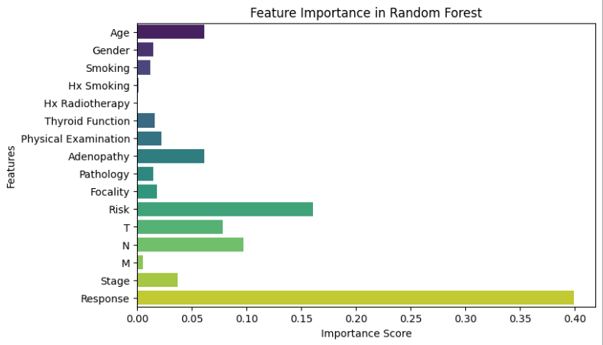
Feature Importance

Slide 13
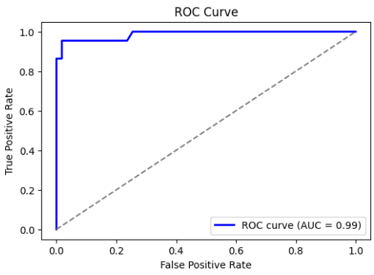
ROC Curve

Slide 14
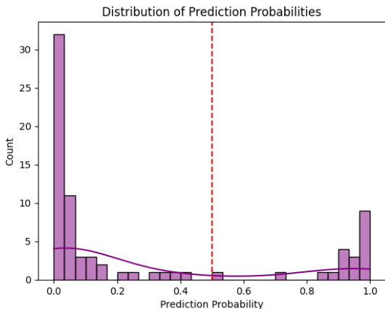
Result

